Slide 1
Course: DS5002 Data Science Tools and Techniques
Data Preprocessing
Dr. Safdar Ali
Explore and discuss the process of data cleaning, with understanding of its importance, common challenges, and effective techniques along with data transformation.

Slide 2
Melt and Pivot functions in Pandas
Used to reshape and manipulate data for useful for analysis.
Both functions help in transforming the layout of your dataset but in different ways.

Slide 3
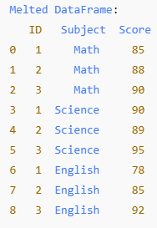
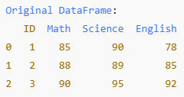
melt() function
It is used to "unpivot" or "flatten" the data, transforming it from a wide format (multiple columns) to a long format (fewer columns).
This function is especially useful when restructure the data for easier analysis or visualization.
Example

Slide 4
import pandas as pd
# Create a sample DataFrame with student scores in different subjects
data = {
'ID': [1, 2, 3], # Student IDs
'Math': [85, 88, 90], # Math scores
'Science': [90, 89, 95], # Science scores
'English': [78, 85, 92] # English scores
}
# Create the DataFrame from the dictionary
df = pd.DataFrame(data)
# Display the original wide-format DataFrame
print("Original DataFrame:")
print(df)
# Use the melt function to convert wide-format data to long-format
# id_vars are the columns we want to keep as is (in this case, 'ID')
# value_vars are the columns we want to unpivot (in this case, the subjects: 'Math', 'Science', 'English')
# var_name is the name of the new column where subject names will go
# value_name is the name of the new column where the scores will go
df_melted = pd.melt(df, id_vars=['ID'], value_vars=['Math', 'Science', 'English'], var_name='Subject', value_name='Score')
# Display the melted (long-format) DataFrame
print("\nMelted DataFrame:")
print(df_melted)

Slide 5
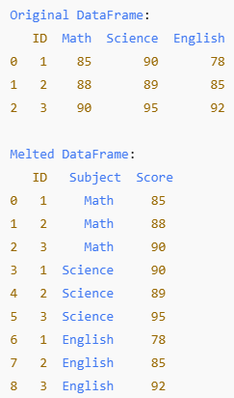
output

Slide 6
pivot() Function
It is used to reshape a long-format DataFrame into a wide-format DataFrame.
In other words, it pivots the unique values from one column into multiple columns.
Example

Slide 7
# Create a long-format DataFrame (similar to the melted DataFrame from earlier)
df_melted = pd.DataFrame({
'ID': [1, 1, 1, 2, 2, 2, 3, 3, 3],
'Subject': ['Math', 'Science', 'English', 'Math', 'Science', 'English', 'Math', 'Science', 'English'],
'Score': [85, 90, 78, 88, 89, 85, 90, 95, 92]
})
# Display the long-format DataFrame
print("Melted DataFrame (Long Format):")
print(df_melted)
# Use the pivot function to convert the long-format DataFrame to a wide format
# The 'ID' column becomes the rows, 'Subject' column values will become columns,
# and the 'Score' values will fill the new table.
df_pivoted = df_melted.pivot(index='ID', columns='Subject', values='Score')
# Display the pivoted (wide-format)
# Display the pivoted (wide-format) DataFrame
print("\nPivoted DataFrame (Wide Format):")
print(df_pivoted)

Slide 8
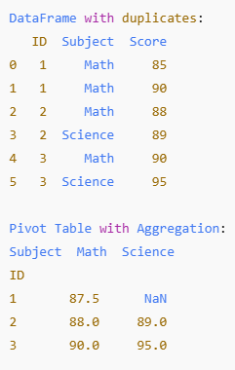
output

Slide 9
Grouping
Grouping is used to aggregate or summarize data by grouping rows that share a common attribute (e.g., summing values by group).
Example:
import pandas as pd
df = pd.DataFrame({
'Category': ['A', 'B', 'A', 'B', 'A', 'B'],
'Value': [10, 20, 30, 40, 50, 60]
})
grouped = df.groupby('Category').sum()
print(grouped)
Output:
Category Value
A 90
B 120

Slide 10
Pivoting
Pivoting reshapes data by turning unique values from one column into new column names and aggregating corresponding values. It essentially "spreads" data across columns.
Must specify the row (index), column (columns), and values to reshape the data.
Output:
Month
Category Jan Feb
A 10 20
B 30 40
Example:
df = pd.DataFrame({
'Category': ['A', 'A', 'B', 'B'],
'Month': ['Jan', 'Feb', 'Jan', 'Feb'],
'Value': [10, 20, 30, 40]
})
pivoted = df.pivot(index='Category', columns='Month', values='Value')
print(pivoted)

Slide 11
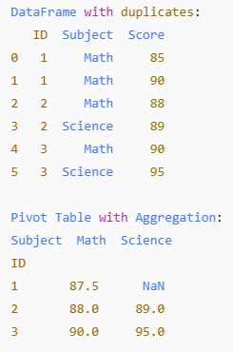
pivot_table()
A more flexible version of pivot() that allows for handling duplicate values through aggregation functions like mean, sum, etc.
# Pivoting will raise an error because of duplicates, so we use pivot_table instead
# Pivot the data with aggregation (taking the mean of duplicate values)
df_pivot_table = df_duplicates.pivot_table(index='ID', columns='Subject', values='Score', aggfunc='mean')
So far, all main functions of PANDAS has been discussed and practiced

Slide 12
Handling Mixed Data Types in a Column
Identify and Inspect the Data
# Load the data into a DataFrame
df = pd.read_csv('your_data.csv')
# Inspect the column with mixed types
print(df['your_column'].head())
Check for Non-Numeric Values (Strings) in Numeric Columns
# Identify non-numeric values
non_numeric_values = df['your_column'].apply(lambda x: isinstance(x, str))
print(df[non_numeric_values])

Slide 13
All column values convert to one data type
Solution: Use pd.to_numeric() to convert strings to numbers (with errors handled).
df['your_column'] = pd.to_numeric(df['your_column'], errors='coerce’)
errors='coerce': This will convert invalid parsing to NaN.
Handle Missing or Invalid Data: After conversion, you may have NaN values where strings could not be converted to numbers.
Replace NaN with a specific value: You might want to replace NaN with a default value (e.g., 0 or the mean of the column).
df['your_column'] = df['your_column'].fillna(0) # Replace NaN with 0
# Or fill with the mean
df['your_column'] = df['your_column'].fillna(df['your_column'].mean())
Drop rows with NaN: If you prefer to drop the rows with missing values:
df.dropna(subset=['your_column'], inplace=True)

Slide 14
Ensure Correct Data Types
After cleaning the data, ensure that the column has the desired data type (integer or float).
# Convert to float
df['your_column'] = df['your_column'].astype(float)
# Convert to integer (if necessary)
df['your_column'] = df['your_column'].astype(int)

Slide 15
Example
import pandas as pd
# Sample DataFrame
data = {'your_column': ['10', '20', 'N/A', '30', 'unknown', '40', '50.5']}
df = pd.DataFrame(data)
# Convert to numeric (invalid strings become NaN)
df['your_column'] = pd.to_numeric(df['your_column'], errors='coerce')
# Fill NaN values with the column's mean (or choose another strategy)
df['your_column'] = df['your_column'].fillna(df['your_column'].mean())
# Ensure the column is of float type
df['your_column'] = df['your_column'].astype(float)
print(df)
Output:
your_column
0 10.00
1 20.00
2 35.25
3 30.00
4 35.25
5 40.00
6 50.50

Slide 16
Grouping
Grouping is used to aggregate or summarize data by grouping rows that share a common attribute (e.g., summing values by group).
Example:
import pandas as pd
df = pd.DataFrame({
'Category': ['A', 'B', 'A', 'B', 'A', 'B'],
'Value': [10, 20, 30, 40, 50, 60]
})
grouped = df.groupby('Category').sum()
print(grouped)
Output:
Category Value
A 90
B 120

Slide 17
Pivoting
Pivoting reshapes data by turning unique values from one column into new column names and aggregating corresponding values. It essentially "spreads" data across columns.
Must specify the row (index), column (columns), and values to reshape the data.
Output:
Month
Category Jan Feb
A 10 20
B 30 40
Example:
df = pd.DataFrame({
'Category': ['A', 'A', 'B', 'B'],
'Month': ['Jan', 'Feb', 'Jan', 'Feb'],
'Value': [10, 20, 30, 40]
})
pivoted = df.pivot(index='Category', columns='Month', values='Value')
print(pivoted)

Slide 18
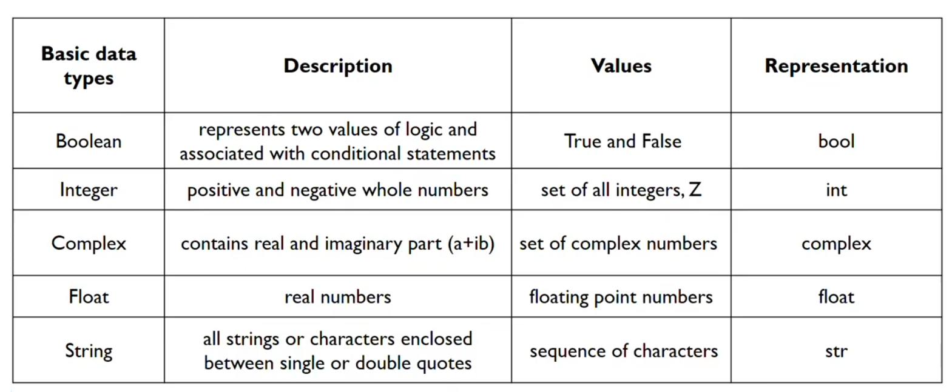
Basic Data Types

Slide 19
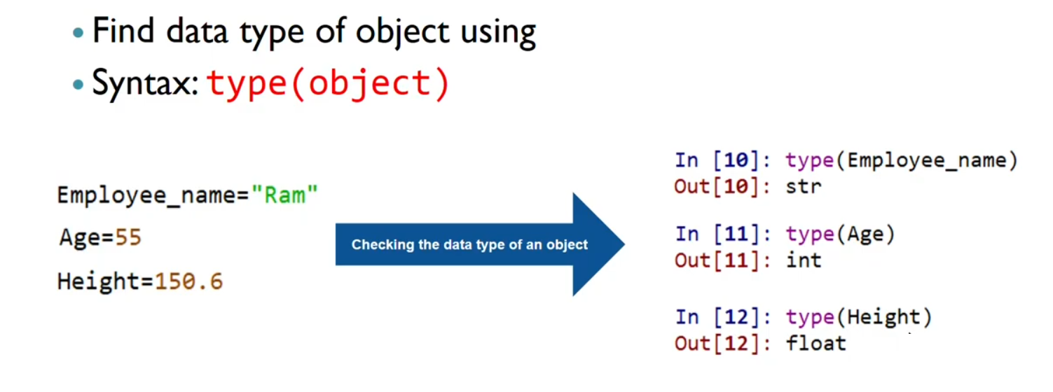
Identifying Object Data Type
“ Ali ”

Slide 20
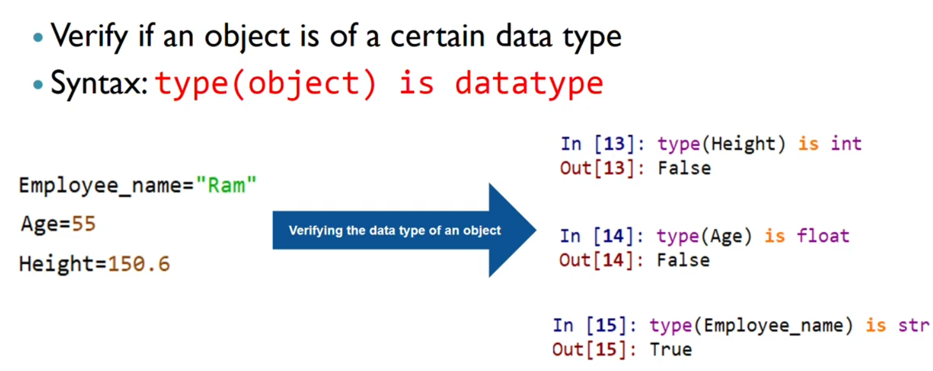
Verifying Object Data Type
“ Ali ”

Slide 21
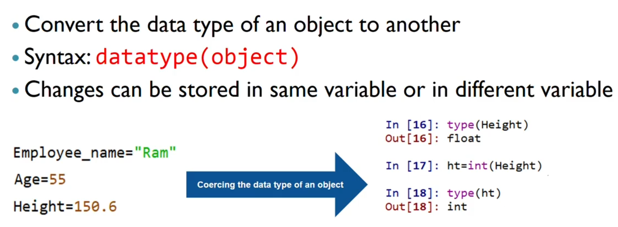
Coercing Object to New Data Type
“ Ali ”

Slide 22
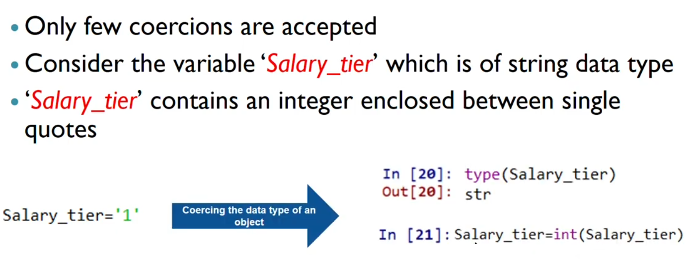
Coercing Object to New Data Type

Slide 23
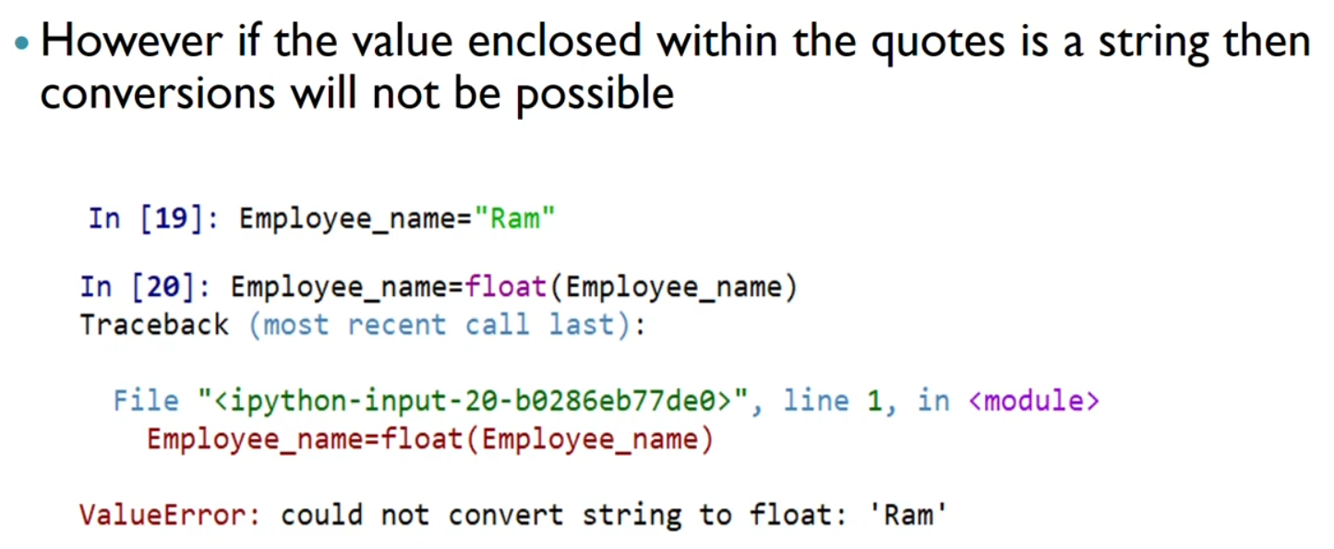
Coercing Object to New Data Type
“ Ali ”

